Slide 1
Signal Processing and Control in Neural Systems
Maryam M. Shanechi
Dept. of Electrical Engineering
Submitted by,
Akshay Hegde
hegdeaks@usc.edu

Slide 2
Clustering with Gaussian Mixture Model(GMM) and Expectation Maximization(EM)
Clustering – separating the data into categories based on some features
- Deals with finding structure in unlabeled data.
- Unsupervised type of algorithms.
- K-means and EM algorithms.

Slide 3
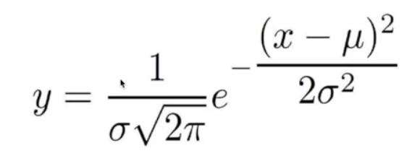

GMM?
Mixture of multiple Gaussians.
Pdf for 1-d gaussian is given by
For d dimensions, the Gaussian distribution is defined by,

Slide 4
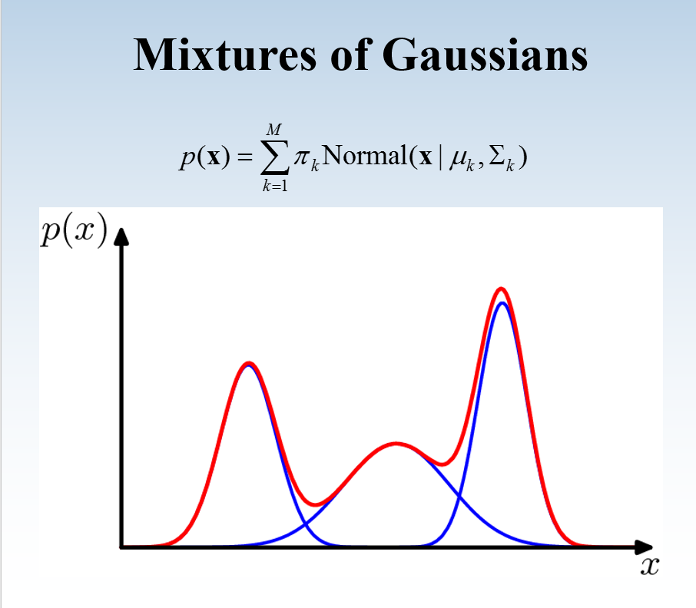
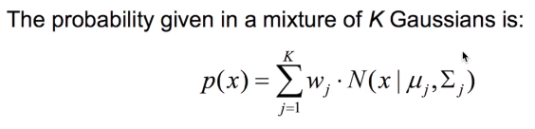

GMM..

Slide 5
Data set used:
“Seeds data set” – UCI Machine Learning repository.
About 3 strains of wheat – Kama, Rosa, Canadian.
1000 instances with 7 attributes.
Dataset characteristics – Multivariate
Attribute characteristics - Real
Features selected for clustering:
Perimeter of the seed
Length of kernel (internal kernel structure is detected with x-ray)
It is concluded as the dataset can be seen as drawn from GMM distribution.

Slide 6


Problem statement: Given the dataset, X = {x1,x2…xn}, estimate the parameters (theta) of the GMM model that fits the data
Solution: Maximize the likelihood of the data with regards to the model parameters
One of the most popular approaches to maximize the likelihood is to use Expectation Maximization (EM) algorithm.

Slide 7
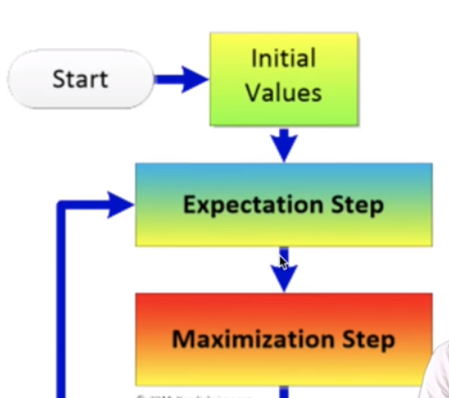

EM
Iterative method for finding maximum likelihood, that estimates parameters in statistical models, when model depends on latent variables.

Slide 8
EM..
Alternates between performing:
E-step – Given the current parameters of the model, estimate probability distribution.(function for estimation of log-likelihood)
M-step – Given the data, estimate the parameters to update the model.(computes parameters maximizing the log-likelihood found in E-step)

Slide 9
Defining the model for this setup,

Slide 10
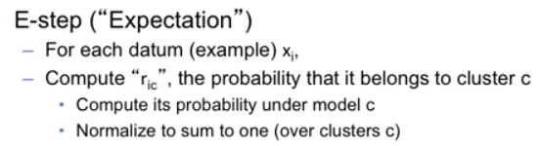


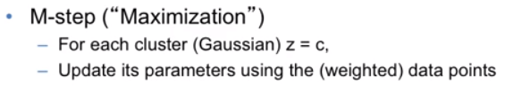




EM..

Slide 11
EM..
Optimizing Parameters,

Slide 12
Language used: Python
Libraries used:
Matplotlib – for plotting
Numpy – for matrix math
Scipy – for normalization
Scipy – for probability density function computation

Slide 13
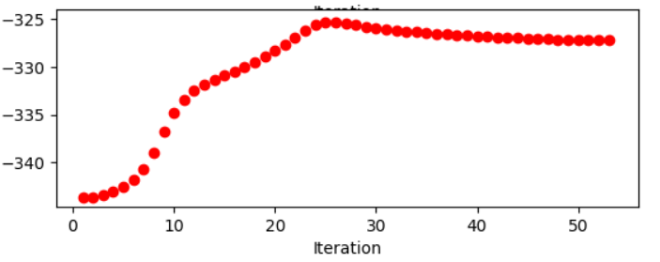
Results and Analysis:
Total Log Likelihood vs Number of EM Iterations,
With 100 instances,

Slide 14
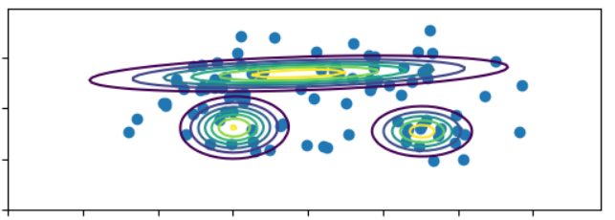

Results..
With 100 instances,
X-axis -- Perimeter of the seed
Y- axis – length of kernel

Slide 15
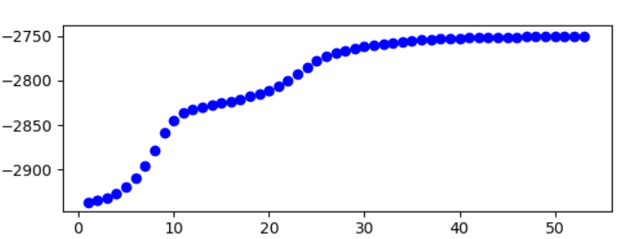
Results..
Total Log Likelihood vs Number of EM Iterations,
With 1000 instances

Slide 16
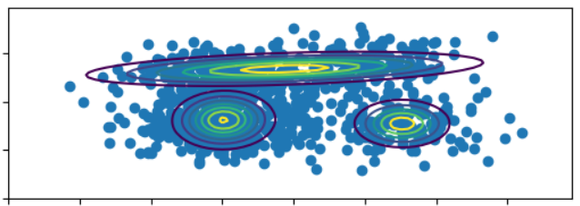
Results..
With 1000 instances,
X-axis -- Perimeter of the seed
Y- axis – length of kernel

Slide 17
Observations..
Final Set of Parameters are same as initial parameters you started with.
Initial Parameters mainly affects the Number of EM Iterations.
If you initialize the parameters with final set of parameters from previous experiment, the number of Iterations will reduce to 2 or 3 for convergence.

Slide 18
Thanks!

